Slide 1


Kubernetes 101
Ravikanth Chaganti github.com/rchaganti/k8s101

Slide 2


Agenda
History
K8s Architecture
Getting Started
Pods
ReplicaSets
Deployments
Services

Slide 3
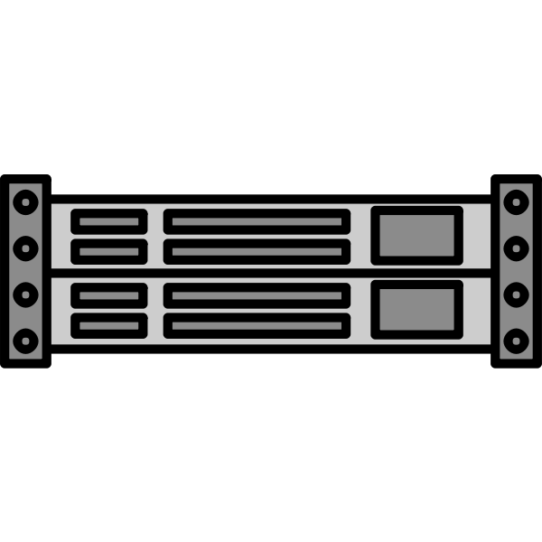
History
Application 1
Application 2
Application 3
Operating System
Operating System
Operating System
Traditional data centers with physical servers

Slide 4
History
Virtual Machines
Virtual Machines
Virtual Machines
Con 1
Con 1
Con 1
Con 1
Con 1
Con 1
Hypervisor
Hypervisor
Hypervisor
Operating System
Operating System
Operating System
Virtualizing applications to increase density

Slide 5
History
App Containers
App Containers
App Containers
Con 1
Con 1
Con 1
Con 1
Con 1
Con 1
Containerization Engine
Containerization Engine
Containerization Engine
Operating System
Operating System
Operating System
Containerization for the scale and agility

Slide 6

Docker Engine
docker CLI
Docker daemon
containerd
runc
runc
runc
runc
App Containers
App Containers
App Containers
App Containers
Docker container host (physical or virtual)

Slide 7
Containerization with Docker
Vote
Result
Frontend
Backend
Redis
Worker
DB
Hands-on

Slide 8
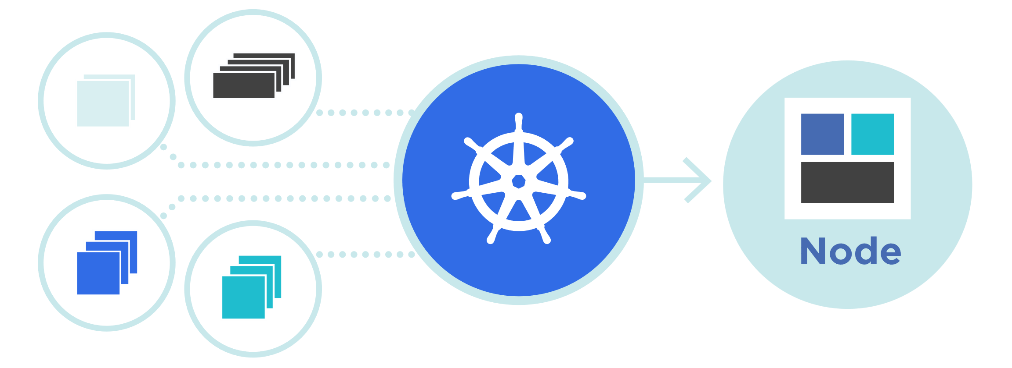
Introduction to Kubernetes
Kubernetes, also known as K8s, is an open-source system for automating deployment, scaling, and management of containerized applications. Builds upon 15 years of experience of running production workloads at Google!

Slide 9
Kubernetes Architecture
Controller manager
Cloud controller manager
Pod 1
Pod 2
Container 1
Container 1
kubectl
Container 2
kube-apiserver
CRI
CSI
CNI
etcd
kube-scheduler
kubelet
kube-proxy
Control Plane
Worker Node(s)

Slide 10
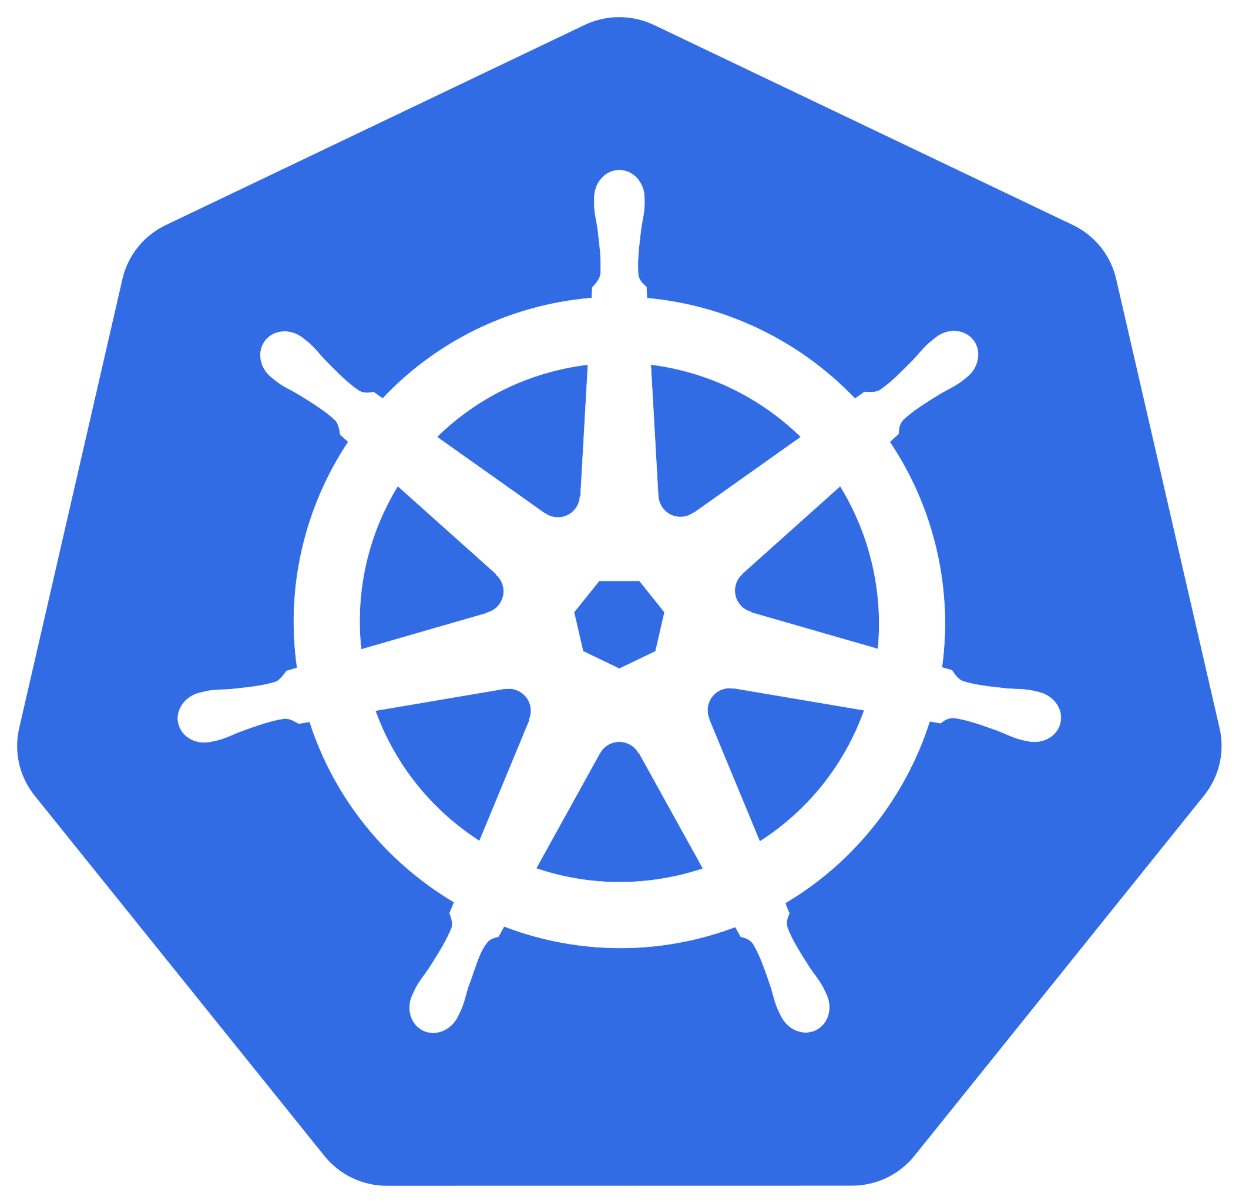
Getting Started
Self-Managed
Managed
Kubernetes
Azure Kubernetes Service
Amazon Elastic Kubernetes Services
Google Kubernetes Engine
Open-source
K3s
Production
Micro K8s
Rancher RKE2
minikube
Docker Desktop
Local Development
Rancher Desktop
KinD

Slide 11
Pods
Pod (Logical Host)
Atomic unit of execution and scaling
Pods enable resource sharing
File system
Network Stack
IPC namespace
Memory
Volumes
Pods are mostly deployed via higher-level controllers such as Deployments
Pods augment containers
Con1:80
Con2:8080
localhost
192.168.0.11

Slide 12
ReplicaSets
Node 1
Node 2
Replica Set
Pod
Pod
Pod
Pod

Slide 13
Deployments
Node 1
Node 2
Deployment
Replica Set
Pod
Pod
Pod
Pod

Slide 14
Services
Node
192.168.0.11
Node
Routing
192.168.0.12
10.244.0.0
10.244.0.0
Pod
Pod
Pod
Pod
10.244.0.11
10.244.0.12
10.244.0.11
10.244.0.12

Slide 15
Services
Node
192.168.0.11
1
TargetPort
3
2
1
31000
Service
Pod
2
Port
5000
10.244.0.11:80
3
NodePort
NodePort

Slide 16
Services
10.244.0.11
10.244.0.12
Pod
Pod
Pod
10.244.0.13
Backend
Pod
Pod
Pod
10.244.0.14
10.244.0.15
10.244.0.16
Redis
Pod
Pod
10.244.0.17
Pod
10.244.0.19
10.244.0.18
ClusterIP

